Slide 1
My Extension for Chapter 01/02
Alexander Spivey

Slide 2
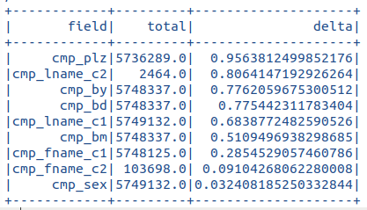
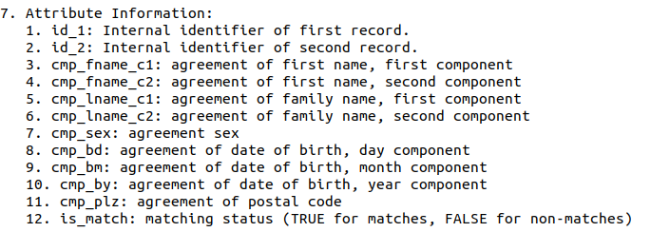
So what fueled this week's endeavor?
Best data point is cmp_plz (mean diff)
What does cmp_plz stand for
What's left?
Cmp_lname_c2: too few entries
Cmp_by: not shabby in diff & thicc
Notes:
At the end of section: Joining DataFrames and Selecting Features
matchSummaryT.createOrReplaceTempView("match_desc") //relate matchSummaryT to match_desc
missSummaryT.createOrReplaceTempView("miss_desc")
spark.sql("""
SELECT a.field, a.count + b.count total, a.mean - b.mean delta
FROM match_desc a INNER JOIN miss_desc b ON a.field = b.field
WHERE a.field not in ("id_1", "id_2")
ORDER BY delta DESC, total DESC
""").show()
Okay well the reason I choose to use cmp_by as my focus was because cmp_plz was the best value from the difference between missed and matched mean. I went to go look at what cmp_plz was in the documentation: cmp_plz: agreement of postal code, which kinda does make sense now that I am typing it out, but I was confused what they meant by postal code. So I decided to go with the next data set, that actually had enough values to work with (cough, cough, cmp_lname_c2).

Slide 3
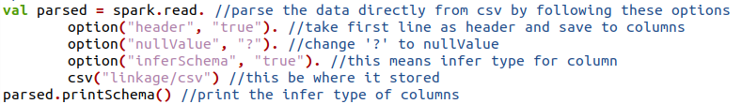
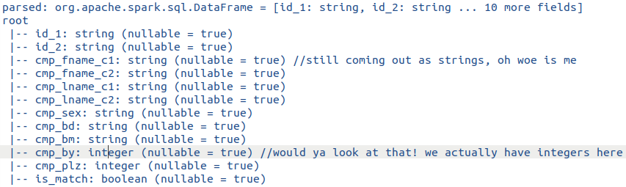

Slide 4
Why are his inferSchema inferring most elements as Strings?

Slide 5
Why is his inferSchema inferring most elements as Strings?
NO IDEA

Slide 6
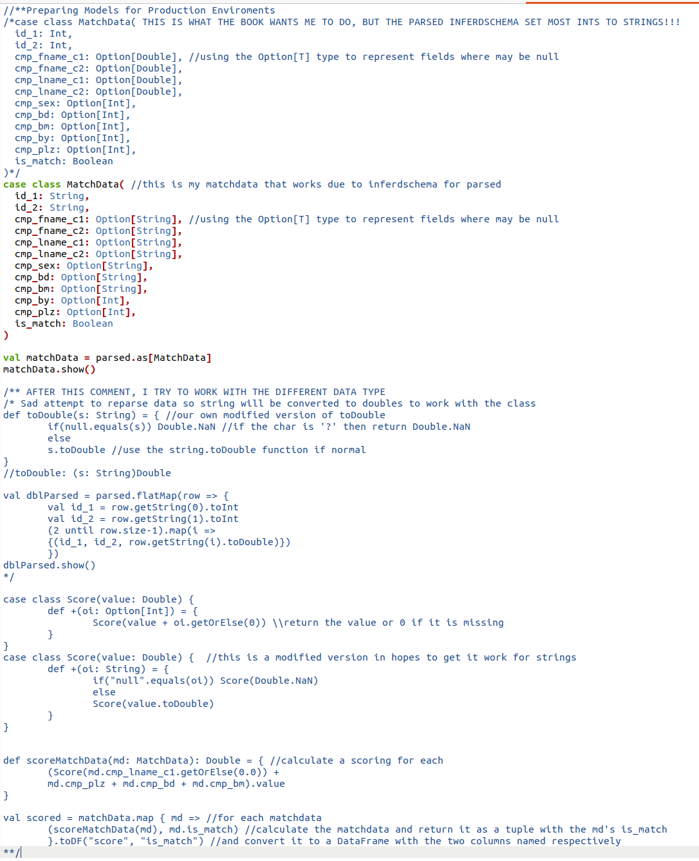
What did you try to fix this?
Notes:
Left side. Tried to do in place conversion using the methods given and tinkering with it
Right side. USED RDD and parsed data!

Slide 7
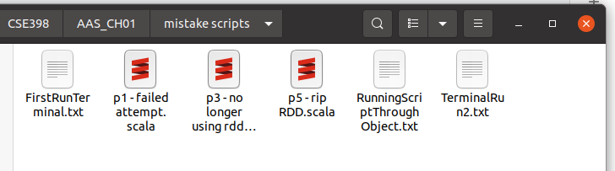
Will he also forget to check the edition before working?
CHECK YOUR EDITIONS!
Notes:
Left side. Tried to do in place conversion using the methods given and tinkering with it
Right side. USED RDD and parsed data!

Slide 8
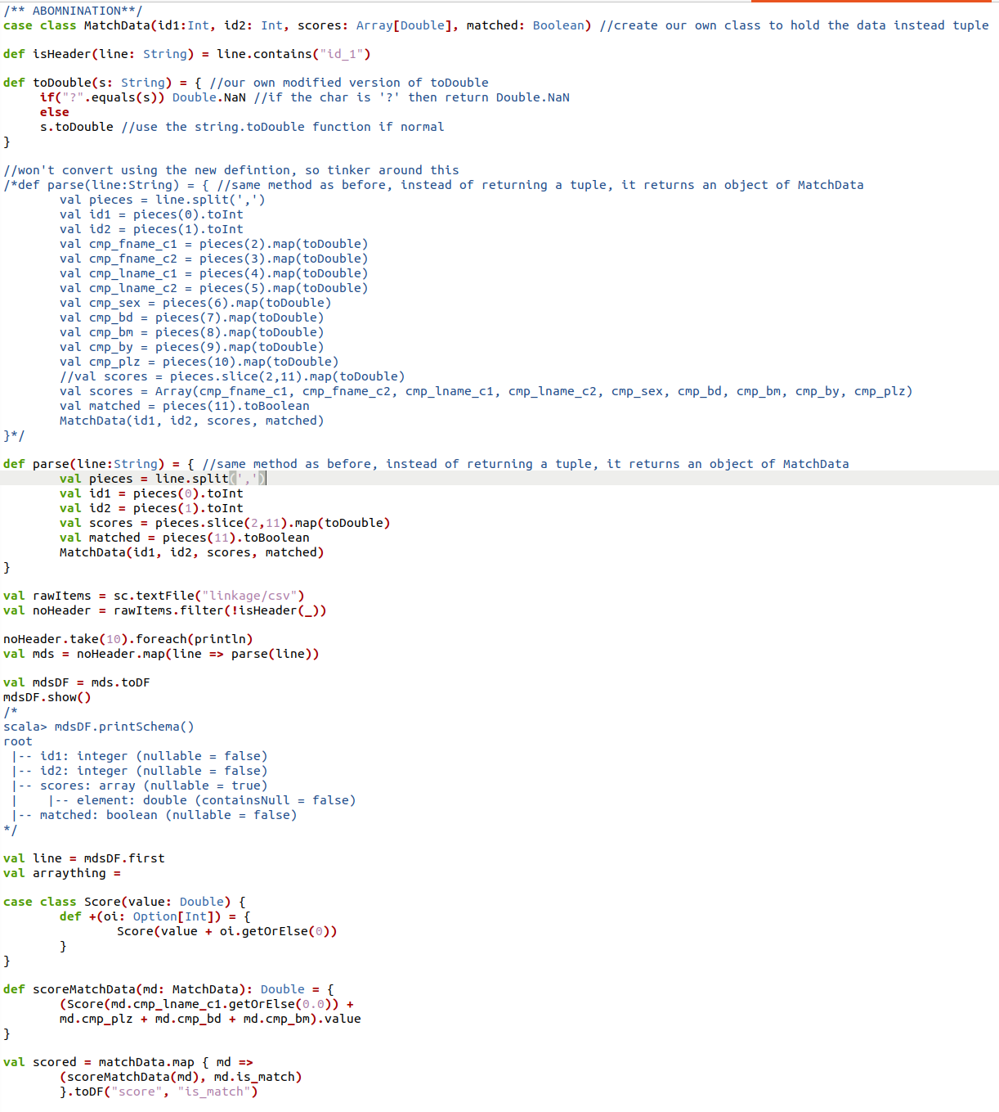
What did you try to fix this?
Notes:
Left side. Tried to do in place conversion using the methods given and tinkering with it
Right side. USED RDD and parsed data!

Slide 9
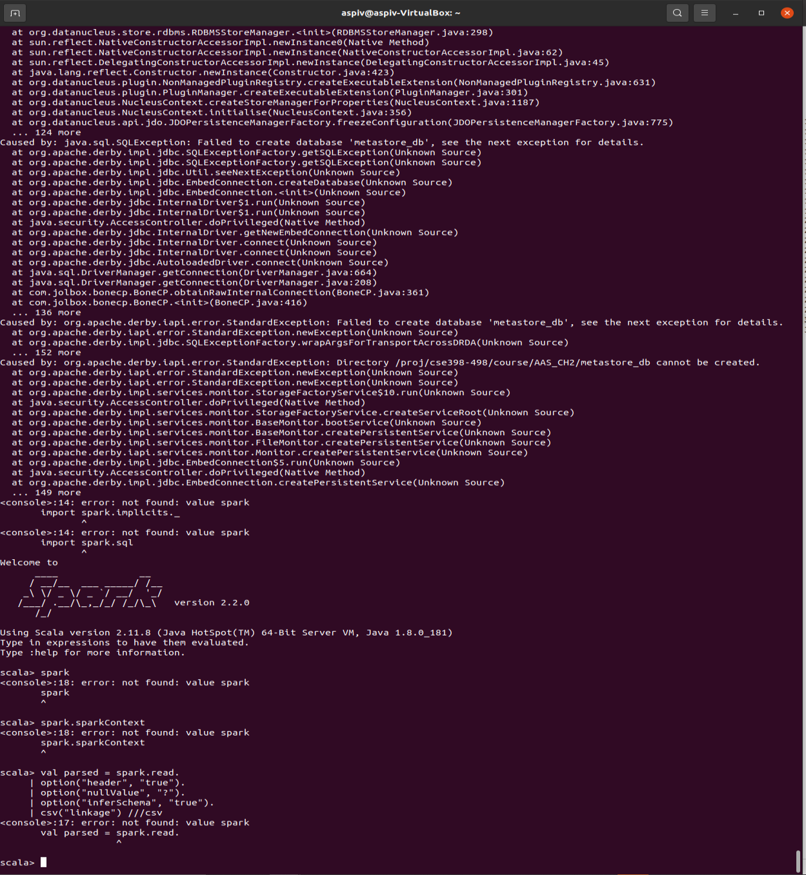
How does this dude break something that comes pre-installed?

Slide 10
Why is inferSchema still inferring most elements as Strings?
Cuz I am bad and somehow broke everything

Slide 11
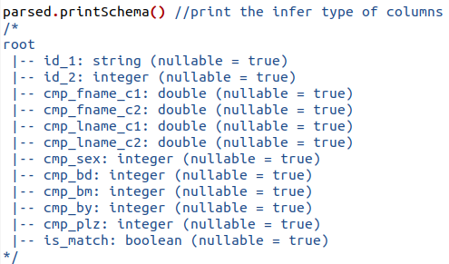
Why is inferSchema still inferring most elements as Strings?
-Update (11:45pm 8/29): Got it to work on ssh

Slide 12
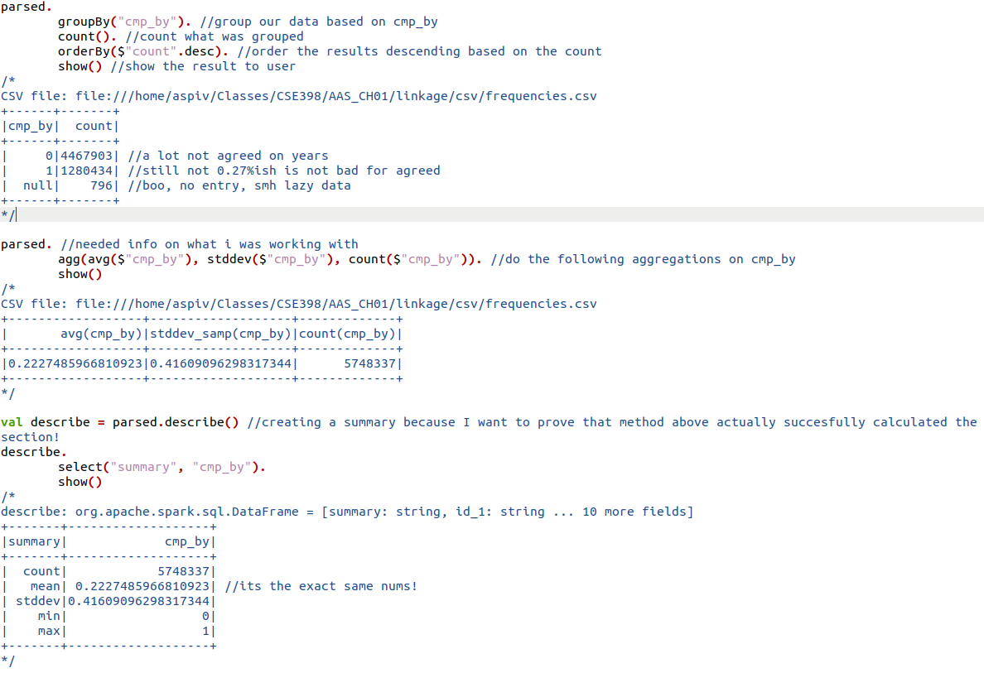

Slide 13
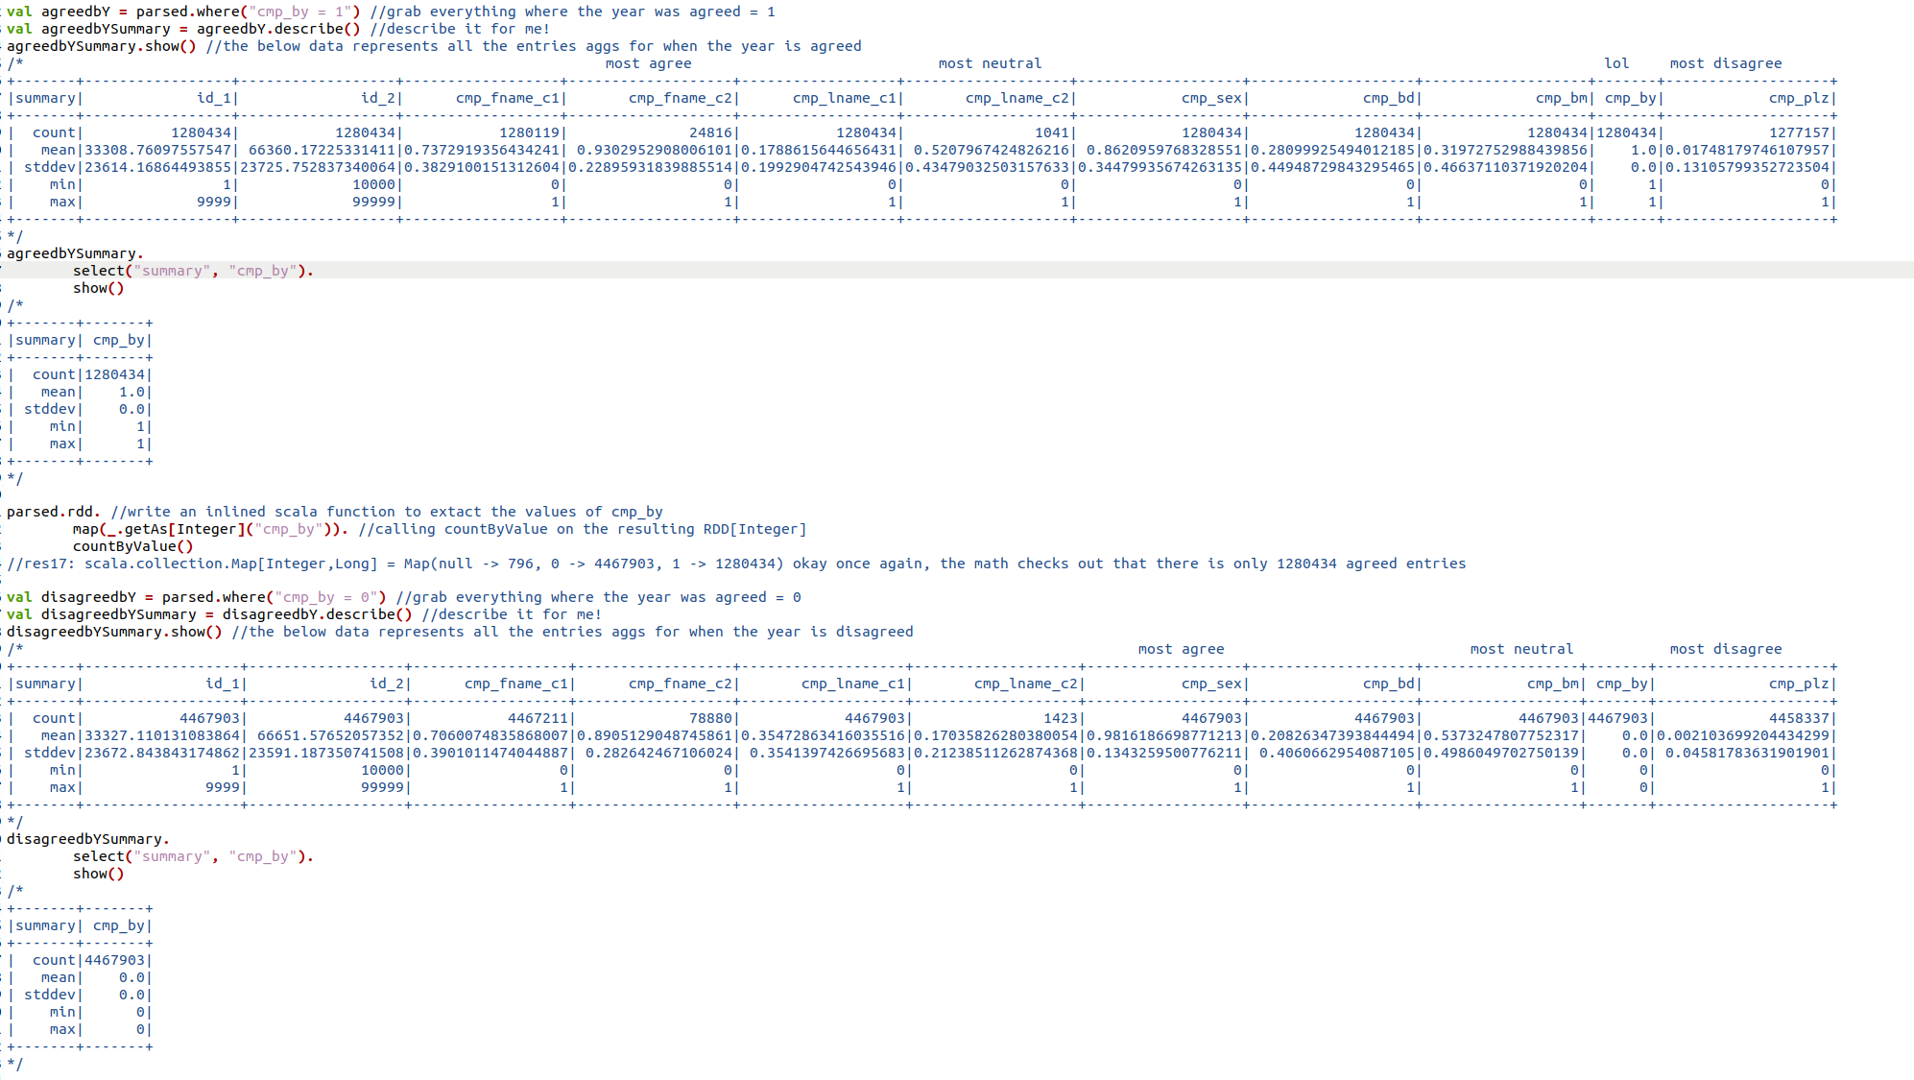

Slide 14
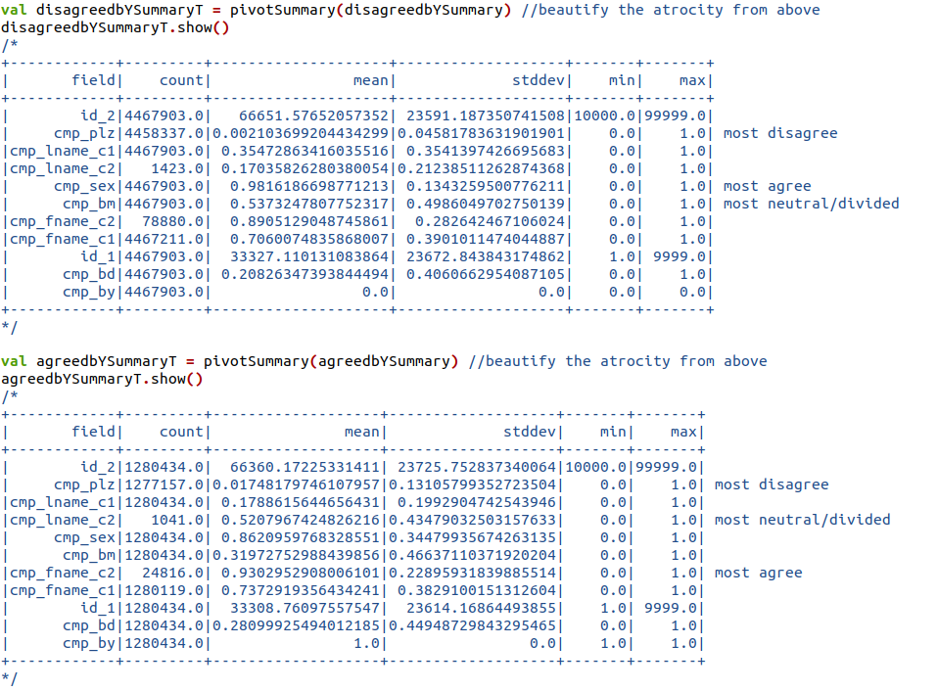

Slide 15
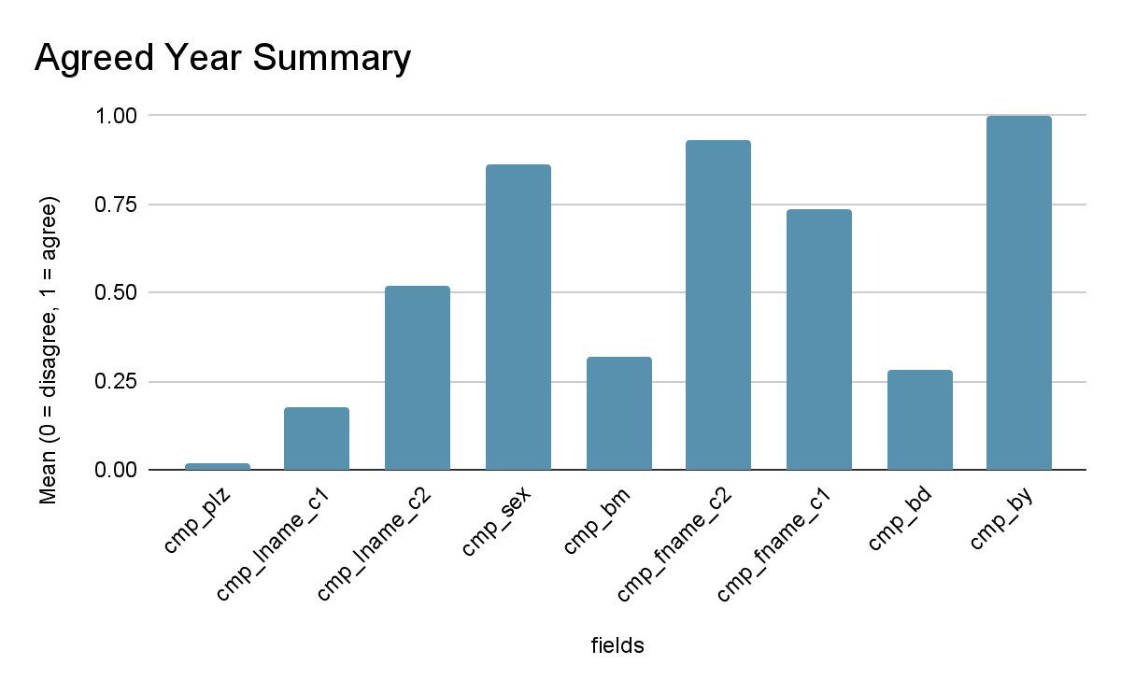

Slide 16
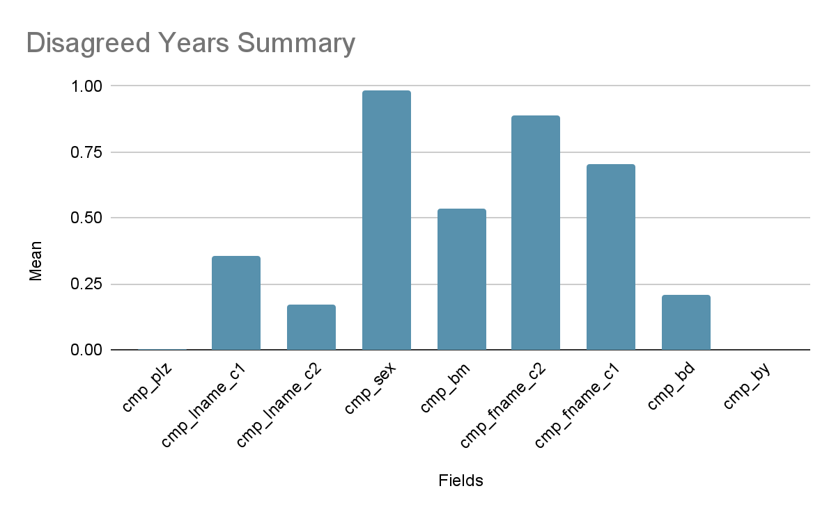

Slide 17
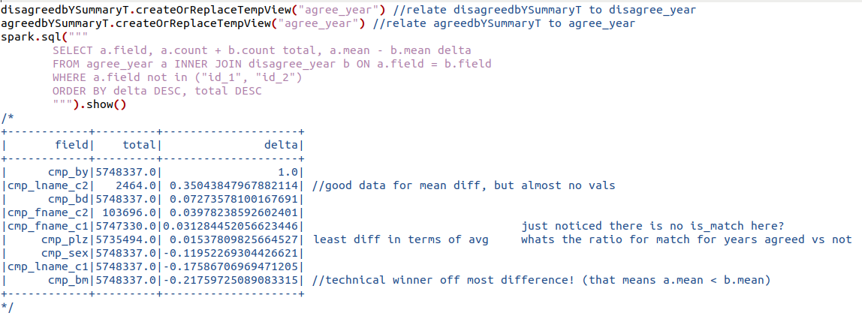

Slide 18
What else can I do?
.describe() cuts of is_match
Find out the lil stats then!
Cmp_plz is most consistently disagreed
Whats the breakdown?

Slide 19
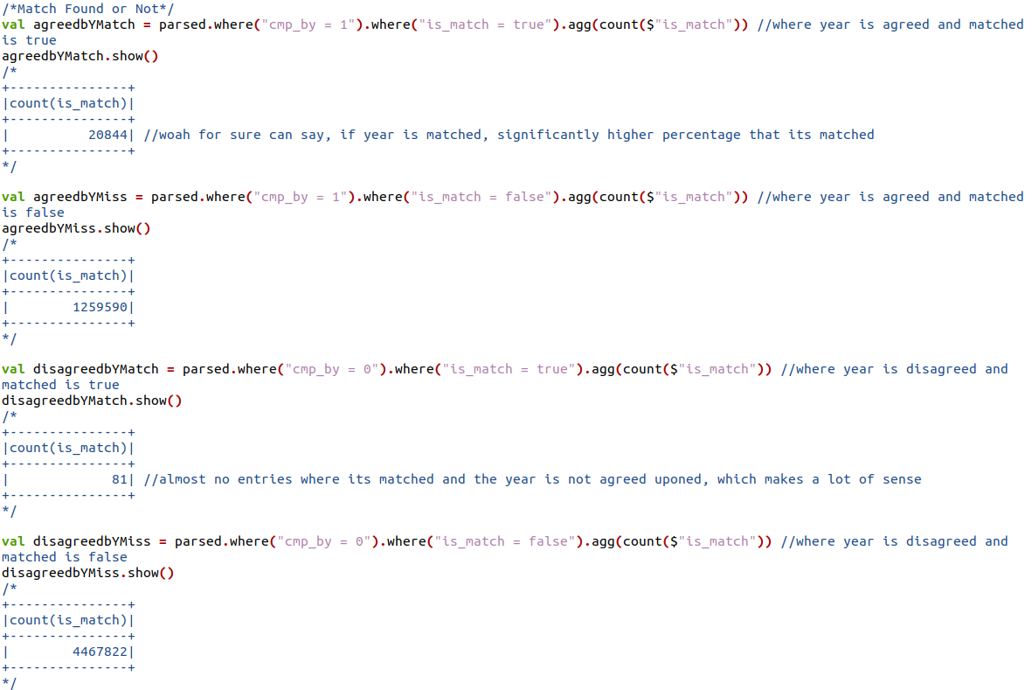

Slide 20
91,177.3282191%
MORE LIKELY TO GET MATCHED WHEN YEAR IS ALSO AGREED ON vs NOT
Notes:
The relative change~!

Slide 21
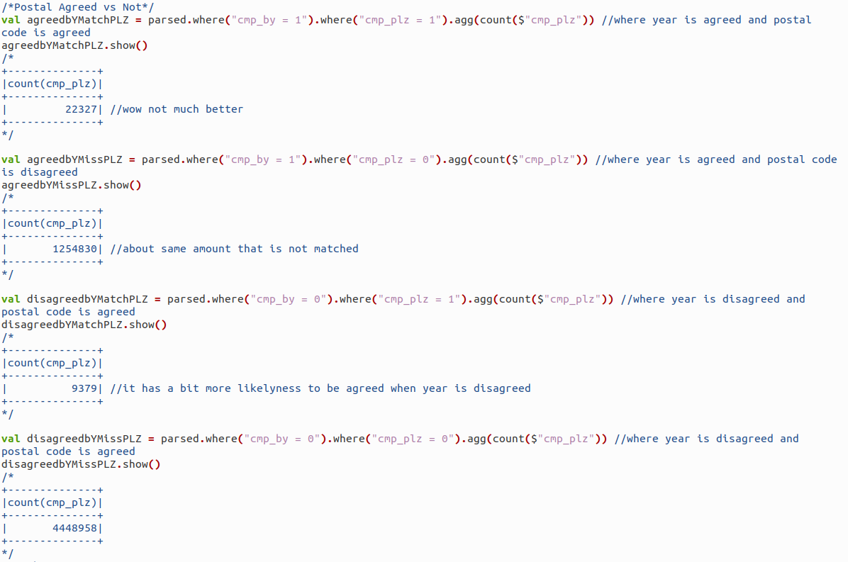

Slide 22
744.0093350%
MORE LIKELY FOR POSTAL CODE TO BE AGREED WHEN YEAR IS ALSO AGREED ON vs NOT

